Slide 1
Academic Writing – a Conversation Why and How How to teach …in the age of ChatGPT
Notes:
Thanks for the invite and for joining us
Prof 11 yrs ago
SLD How many familiar?
3-4 students pw, 100+ annual, >1000 total
Mainly 80% Humanities, Social Sci, Nursing
75% UG 75% Female
Mix writing and 'tutorial issues' eg communication issues
Why: enjoy working 1:1
+ Other people's backyard

Slide 2
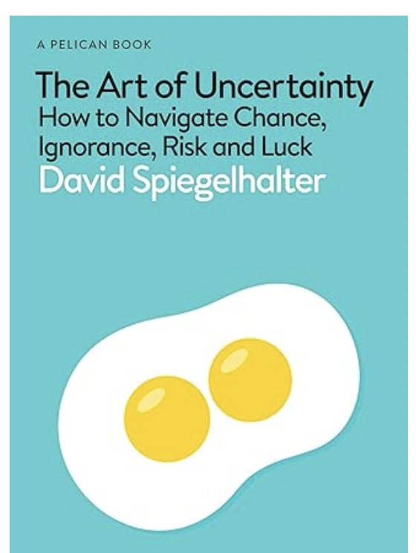
Homework – History vs Maths
“A hazard of teaching mathematics rather than, say, history is that the homework is a lot harder to come up with.
After all, "was Henry VIII a good king?" is a reasonable question to ask either a classroom of nine-year-olds or a lecture theatre of postgraduates.
But "solve this quadratic equation" would leave the classroom nonplussed and the lecture theatre unimpressed.”
Economist Review Oct 24
Notes:
Quadratic functions are good. Discuss
What is good

Slide 3
Homework - Statistics
“All models are wrong, but some are useful.” Box, 1976
Discuss critically in five paragraphs
Notes:
For which student group?

Slide 4
Student Learning Development
SLD https://www.tcd.ie/sld/ Blackboard ASSL202425
SCS Student Counselling Service
TCD Tutorial system incl Postgraduate Advisory Service.
AP Academic Practice CAPSL
Notes:
Learning skills
Asking questions
Maths vs PG Cert (prev Diploma)
Process not product
Is a Lecture a conversation?
Corr 0.236317

Slide 5
Academics Write Critically
Papers for publication
Professional Reports
Blogs, Grant Proposals, LinkedIn
Trainee Academics write
Theses & Project Dissertations
Essays & Lab reports
Notes:
Students as Trainee Academics? or Professionals
Phrase perplexing to many beginners
Where trained in writing?
What is Scholarly Writing?
Should SCSS encourage it? Develop it using essays?
??Also poetry, pop science, novels....

Slide 6
Writing in the Disciplines Humanities Sciences Professions
Professional Report •Dissertation
Thesis • Journal paper
Intro, Conclusion.. •Lit Rev

Slide 7
Basic Essay Writing Methodologies
Say what you’re going to say, ......
Point, Example, Explain PEE
Five Para Essay – Thesis Statement
Notes:
Entry Level Emma
College Level – Critical Treading Writing Thinking
- Professional Judgement - Statistical Thinking
- Art Hist PhD Thesis Statement

Slide 8
Contribute to a Conversation
Within the brief……
Identify critical reader
PhD External Examiner
Professor Grader
Classmate
Make a perceptive observation
Persuade reader interesting in a specified sense
but don’t lose your reader
Notes:
Conversations. Question in class?
Grading Lifeguard falling asleep?

Slide 9
Homework - Statistics
“All models are wrong, but some are useful.” Box, 1976
Discuss critically in five paras

Slide 10
Thesis Statements
“All models are wrong, but some are useful.”
This statement is a truism; empirical models are simplifications
Henry VIII / Quadratics
Quadratics are good equations
Notes:
Box often misquoted

Slide 11
Generative AI
Student Learning/TCD Library HITS
https://www.tcd.ie/library/assets/pdf/Library-HITS/Applying%20GenAI.pdf
Academic Practice
https://www.tcd.ie/academicpractice/resources/generative_ai/
Voices from the Disciplines
Student Perspectives
Notes:
Surprisingly, no SCSS
Different versions of AI: Academic Integrity,

Slide 12
Concluding Thoughts
Are (all our) students ‘trainee academics’?
Critical thinking - professional judgement
GenAI - in teaching, grading and feedback
Practical “how advice” for students
Practical “how advice” for staff
Notes:
Scholarly

